Slide 1



Digital Portfolio
STUDENT NAME: DIVYA BHARATHI S.M REGISTER NO : 212402475 & FA06282BF7F942B97C04B2566D5AA291
DEPARTMENT: BCA
COLLEGE: AM JAIN COLLEGE
1

Slide 2
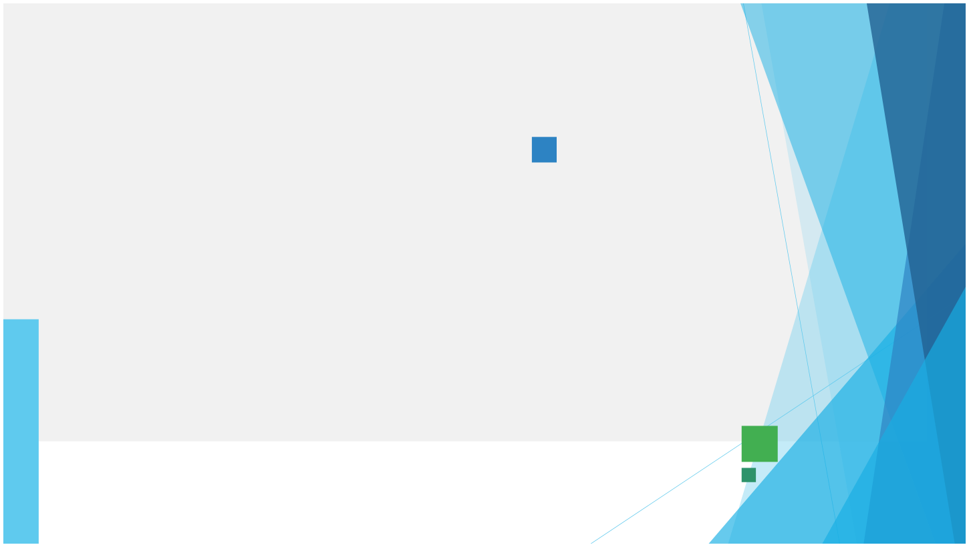

DIGITAL POTFOLIO
2

Slide 3

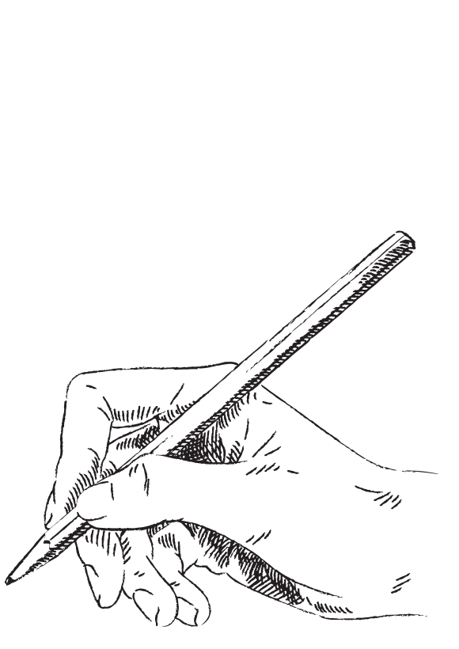


AGENDA
1.Problem Statement
2.Project Overview 3.End Users 4.Tools and Technologies 5.Portfolio design and
Layout
6.Features and
Functionality
7.Results and Screenshots 8.Conclusion 9.Github Link
3/21/2024 Annual Review
3

Slide 4


PROBLEM STATEMENT
Many professionalsstruggle toshowcase
their skills, experience, and projects in an engaging and accessible manner. A personal portfolio website solves this problem by providing a modern, interactive, and user-friendly platform.
4

Slide 5

PROJECT OVERVIEW
Thisprojectis a responsive portfolio website created byDivya Bharathi. It highlights personal background, skills, and projects (e-commerce, travel blog, fitness app). It also includes an interactive design with animations, smooth navigation, and a contact form for communication .
5

Slide 6
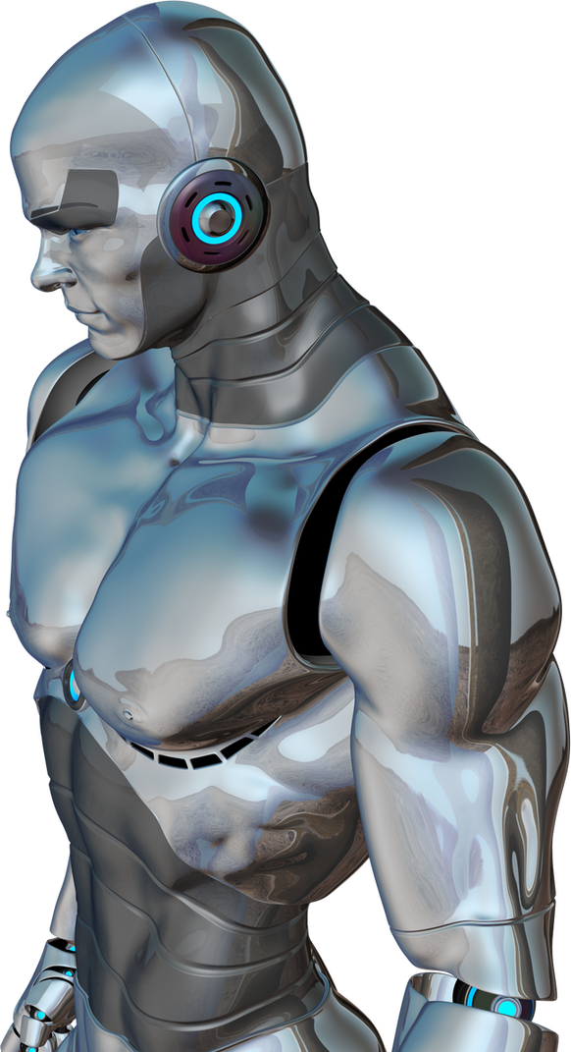
WHO ARE THE END USERS?
Recruiters and hiring managers Potential clients Collaborators and peers in tech/design General visitors interested in Divya’s work
6

Slide 7

TOOLS AND TECHNIQUES
Frontend: HTML5,
CSS3, JavaScript
Frameworks/Libraries:
React, Node.js
Database: MongoDB
Design Tools: Google
Fonts, Font Awesome
7

Slide 8


POTFOLIO DESIGN AND LAYOUT
Modern responsive design with sections: Home, About, Skills, Projects, Contact Smooth scrolling and mobile-friendly navigation (hamburger menu) Hero section with intro and call-to- action buttons Interactive project cards with icons and hover effects Contact form and social media integration
8

Slide 9

FEATURES AND FUNCTIONALITY
Responsive UI/UX across devices Animated buttons with sparkle effect Project showcase (E-commerce website, Travel blog, Fitness app) Contact form with fields for name, email, and message Social media links (GitHub, LinkedIn, Twitter, Instagram)

Slide 10
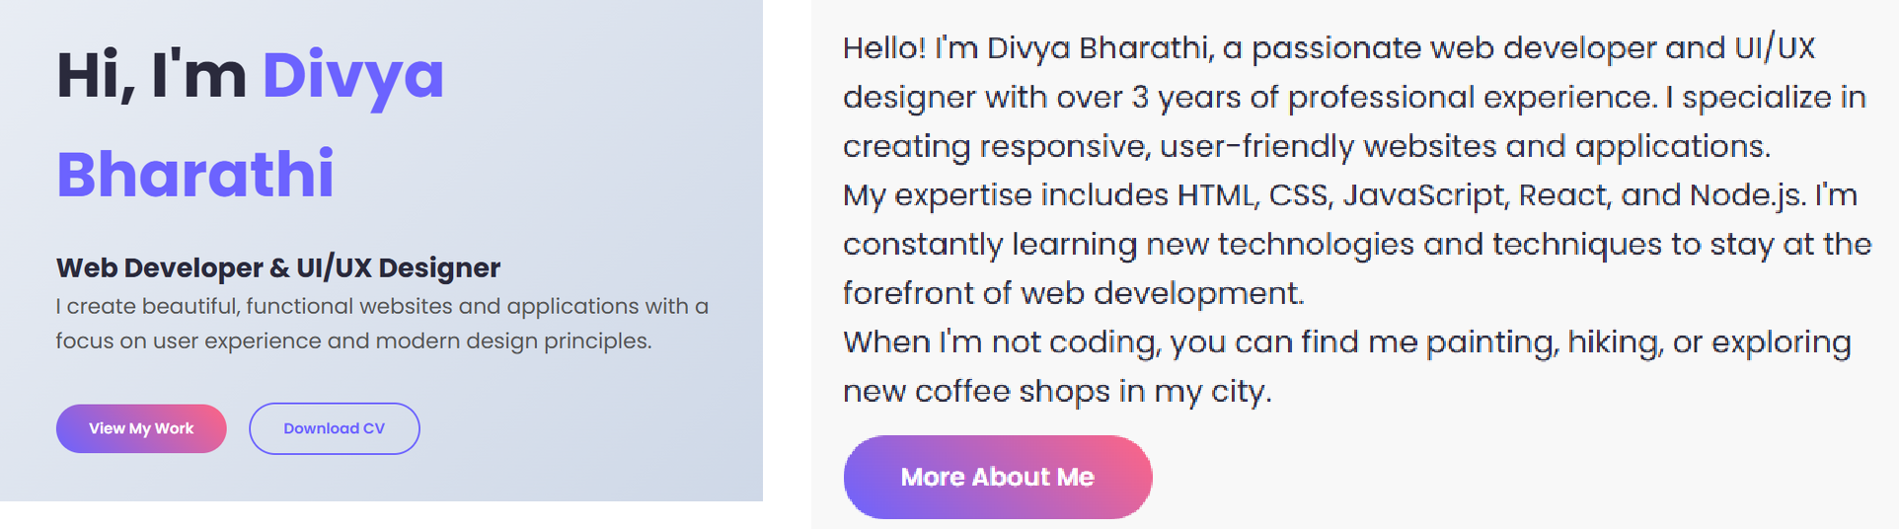
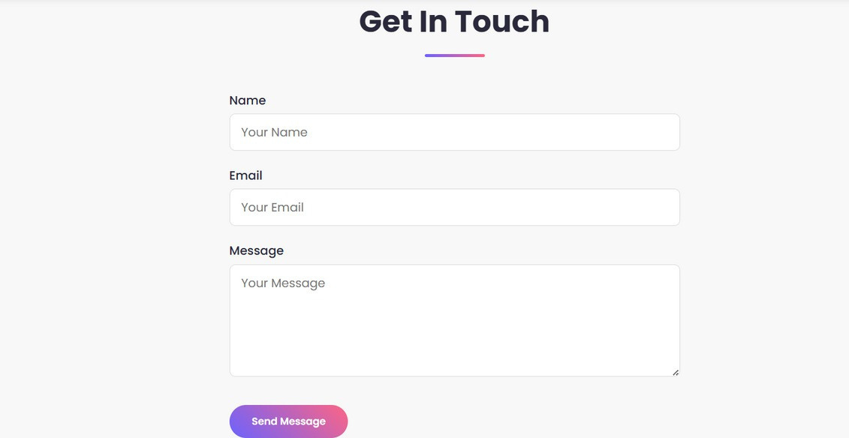
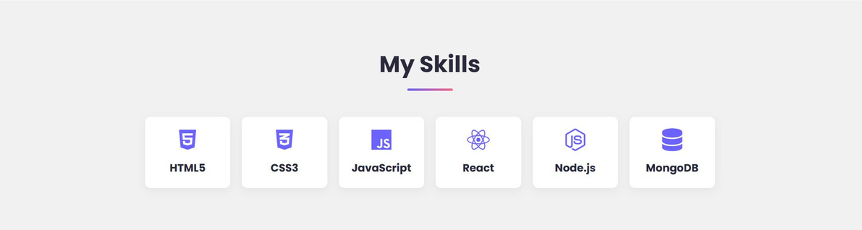
RESULTS AND SCREENSHOTS
3/21/2024 Annual Review
10

Slide 11



CONCLUSION
The portfolio website successfully provides an engaging platform to present skills, projects, and contact details in a professional manner. It enhances personal branding, increases visibility, and helps in career growth.
11

Slide 12
SERVER LINK
https://github.com/24h238-svg/TNSDC-FWD-DigitalPortfolio.git
DEPOLYMENT LINK
https://24h238-svg.github.io/TNSDC-FWD-DigitalPortfolio/

